Slide 1
Which Patterns Are Interesting?
Pattern Evaluation Methods
Shen, Chih-Ya (沈之涯)
Department of Computer Science
National Tsing Hua University

Slide 2
1
Strong rules are not necessarily interesting
10,000 transactions: 6,000 include games, 7,500 include videos, 4,000 include both game and video
A strong association rule is thus derived (min_sup=30%, min_conf=60%):
This rule is MISLEADING, because probability of videos is 75% > 66% (buying game and video together)
In fact, games and videos are negatively associated Buying one actually decreases the likelihood of buying the other

Slide 3
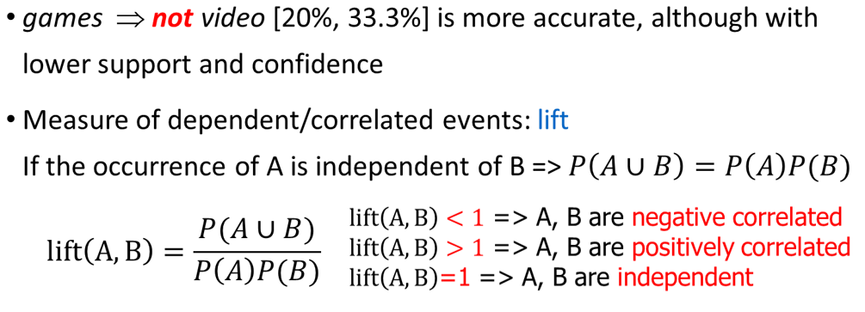
1
Interestingness Measure: Correlations (Lift)
 | Game | Not game | Sum (row)
Video | 4000 | 3500 | 7500
Not video | 2000 | 500 | 2500
Sum(col.) | 6000 | 4000 | 10000

Slide 4

1
Interesting Measure: Chi-square($X^{2}$)
Χ² (chi-square) test
The larger the Χ² value, the more likely the variables are related
The cells that contribute the most to the Χ² value are those whose actual count is very different from the expected count
Correlation does not imply causality
# of hospitals and # of car-theft in a city are correlated
Both are causally linked to the third variable: population

Slide 5



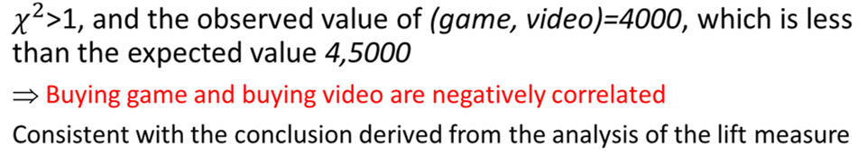

1
Interesting Measure: Chi-square($X^{2}$)
括號裡面是expected value
Notes:
Game U Video 的expected value = (# game) * (# video)/total = 6000*7500/10000 = 4500
Not Game U Video = 4000*7500/10000 = 3000

Slide 6
1
Pattern Evaluation Measures
all_confidence: Minimum confidence of “A=>B” and “B=>A”
max_confidence: Maximum confidence of “A=>B” and “B=>A”
Kulczynski: Average confidence of “A=>B” and “B=>A”
Cosine:
All four measures have their values in [0,1]

Slide 7
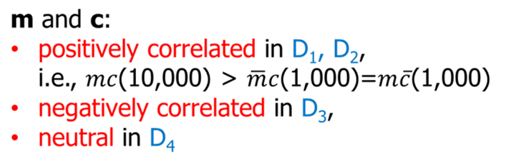
1
Comparison of Interestingness Measures

Slide 8
1
Comparison of Interestingness Measures
All the four new measures show m and c are strongly positively associated

Slide 9
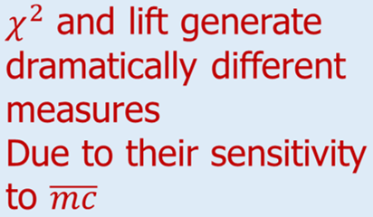

1
Comparison of Interestingness Measures

Slide 10
1
Comparison of Interestingness Measures
All the four new measures show m and c are strongly negtively associated

Slide 11
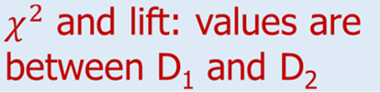
1
Comparison of Interestingness Measures

Slide 12
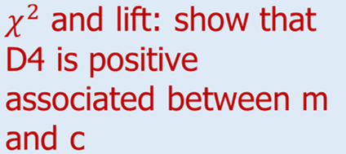
1
Comparison of Interestingness Measures

Slide 13
1
Comparison of Interestingness Measures
It is neutral as indicated by the four measures.
A customer buys coffee (or milk), the probability of buying milk (of coffee) is exactly 50%
Notes:
2022.2.22到此

Slide 14
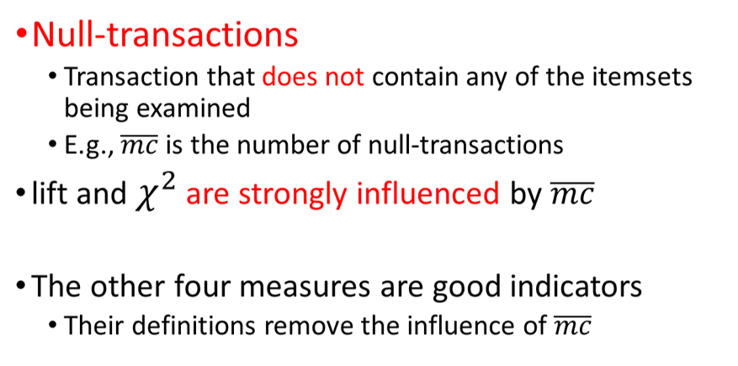

1
Why are lift and $X^{2}$ so poor?

Slide 15
1
Which Null-Invariant Measure Is Better?
Events m and c have imbalanced conditional probabilities
In D₅ and D₆:
mc/c > 0.9
mc/m < 0.1
For (mc,c), (mc,m)
All_conf. and cosine=> view both as negative associated
Max_conf. => view both as positive associated
Kulc => view both as neutral

Slide 16
1
Which Null-Invariant Measure Is Better?
mc/m = 9.09% in D₅, and 0.99% in D₆ => negative associated
mc/c = 90.9% in D₅, and 99% in D₆ => positive associated
Could be fair to treat it as neutral

Slide 17
1
Which Null-Invariant Measure Is Better?
IR (Imbalance Ratio): measure the imbalance of two itemsets A and B in rule implications

Slide 18
1
Which Null-Invariant Measure Is Better?
Kulczynski and Imbalance Ratio (IR) together present a clear picture for all the three datasets D₄ through D₆
D₄ is balanced & neutral (IR(m,c)=0 => perfect balanced)
D₅ is imbalanced & neutral (IR(m,c)=0.89 => imbalanced)
D₆ is very imbalanced & neutral (IR(m,c)=0.99 => very skewed)

Slide 19
THANK YOU!

